Slide 1
Meteorite Recovery Using Drones: Initial Successes and Future Plans
Hadrien Devillepoix,
Seamus Anderson,
Desert Fireball Network team.
Space Science and Technology Centre
International Centre for Radio Astronomy Research
Curtin University
Perth, Australia

Slide 2
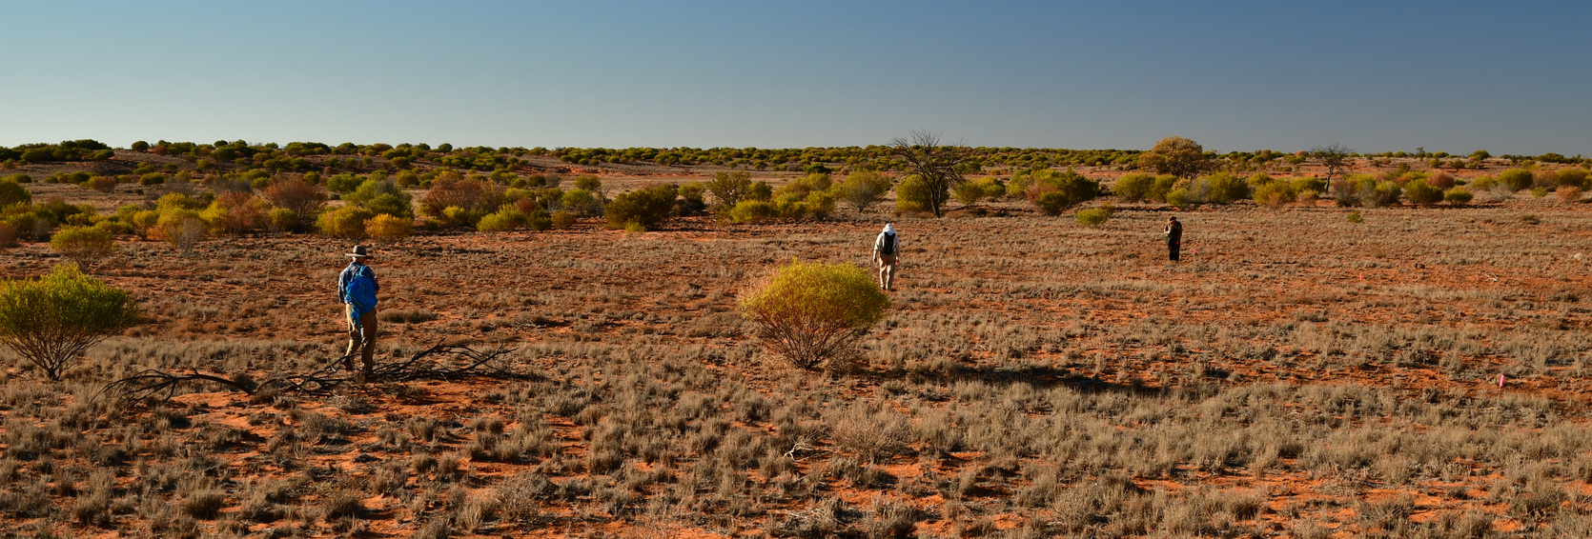

Slide 3
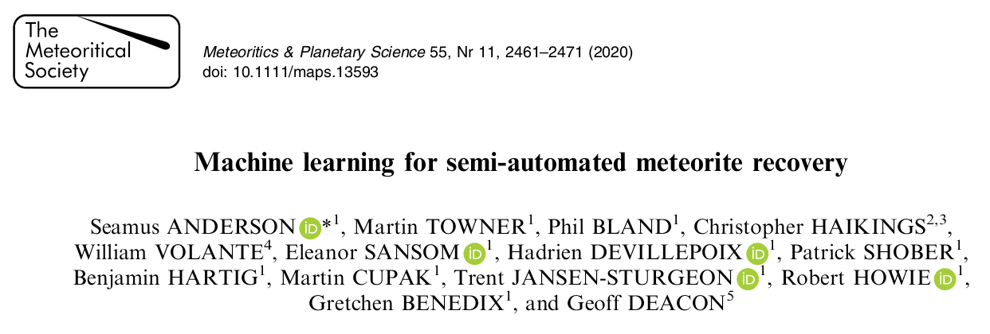

Slide 7
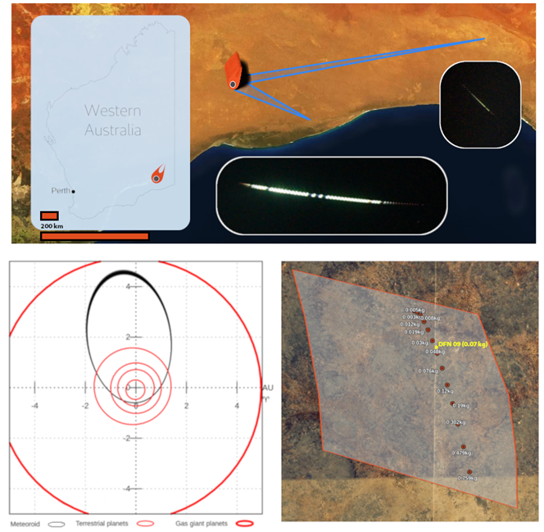

Slide 8
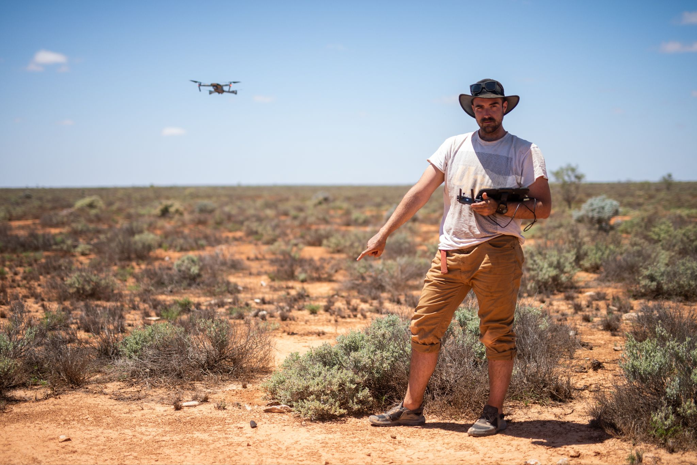
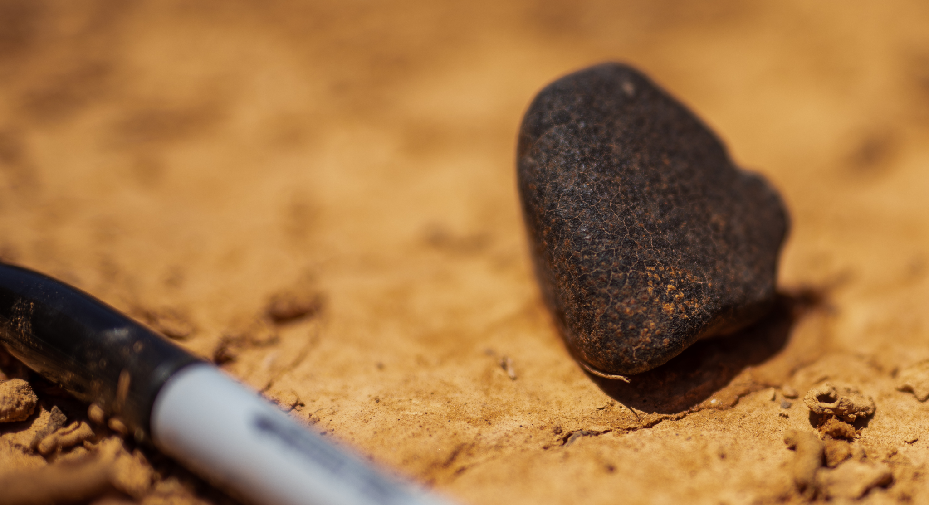

Slide 9
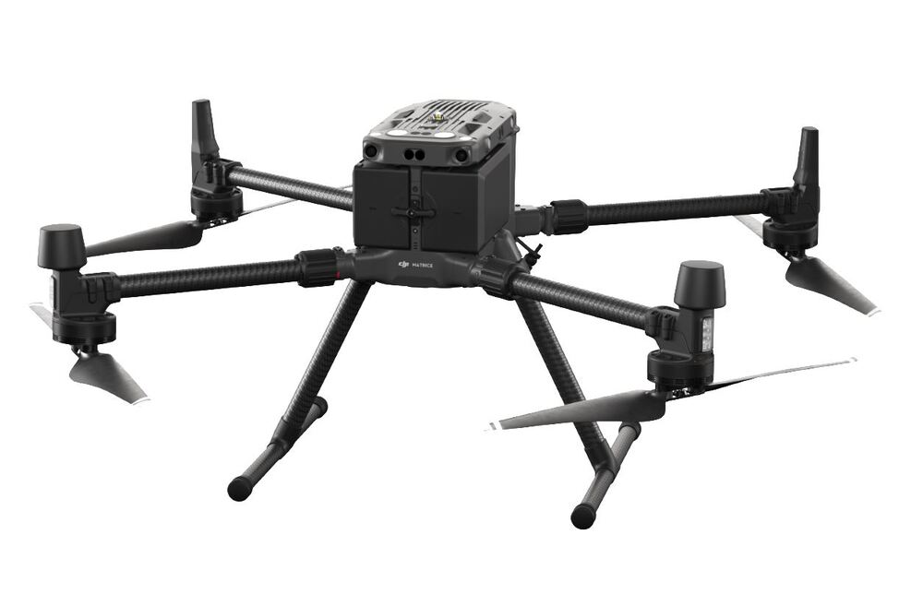
Survey
DJI M300 + Zenmuse P1 50mm lens
Covers a fall zone in 3~5 days
Hot swappable batteries
44 MP camera
Flight height: 20m
1.8 mm/pixel ground resolution
0.3 TB /km²

Slide 10
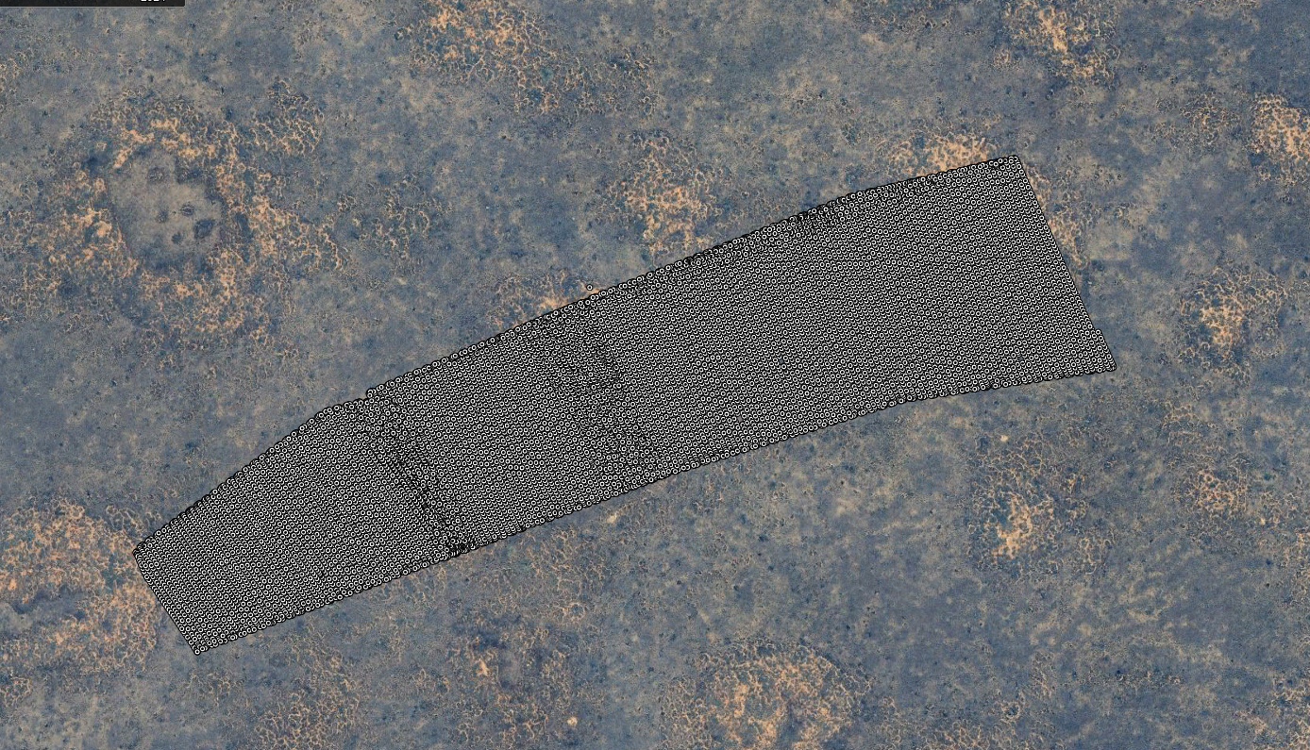

Slide 11
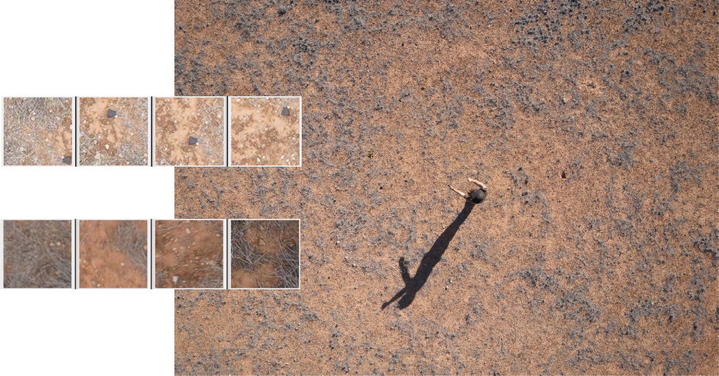
Training
data

Slide 12
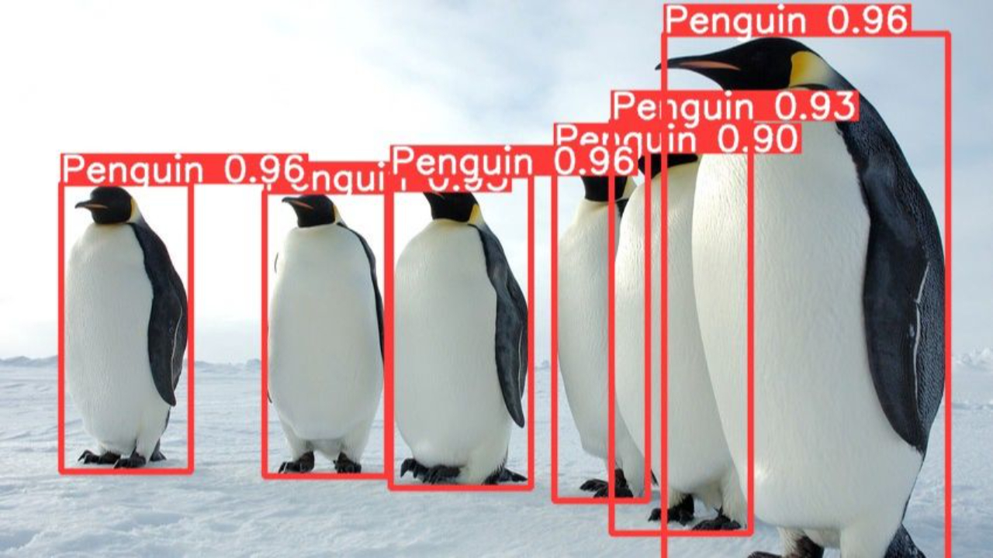
YOLOv8

Slide 13
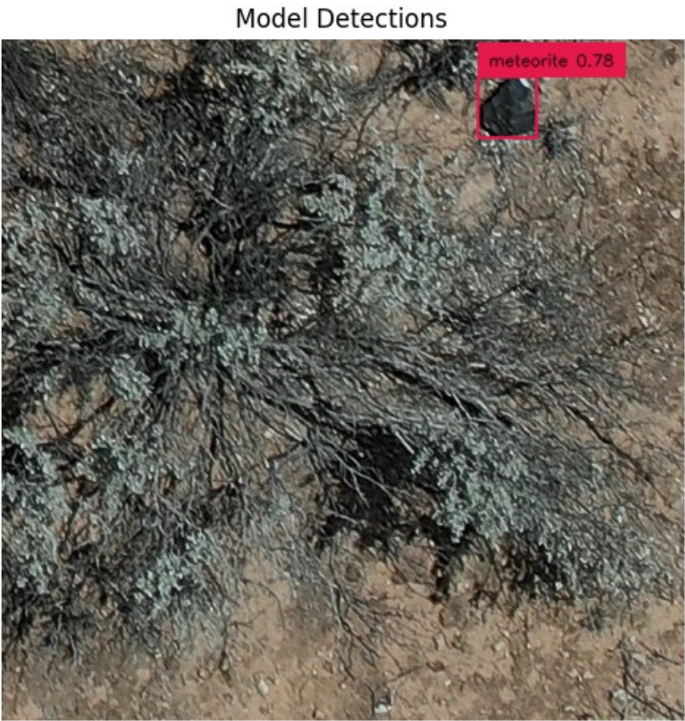

Slide 14
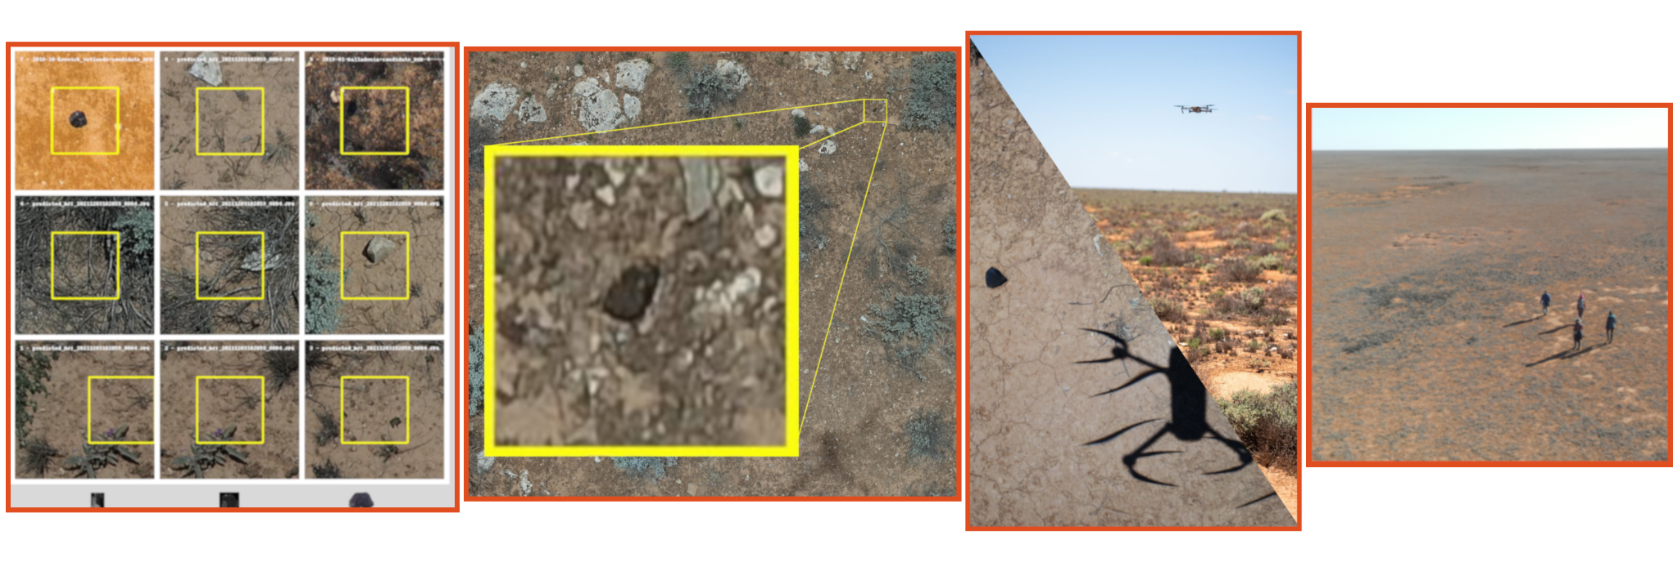
Candidates review
10⁵ -> 10³ -> 10² -> 10¹

Slide 15
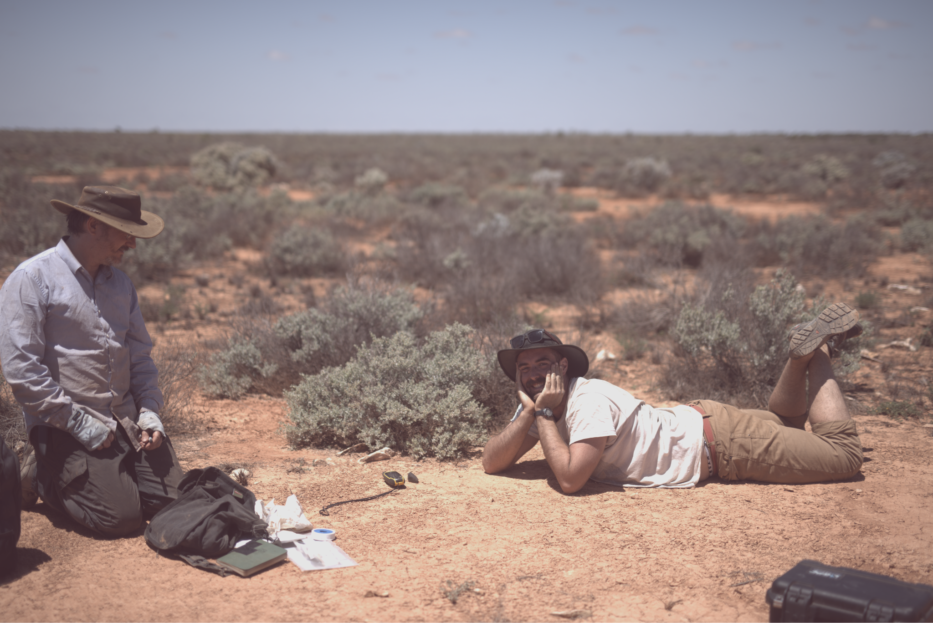

Slide 17
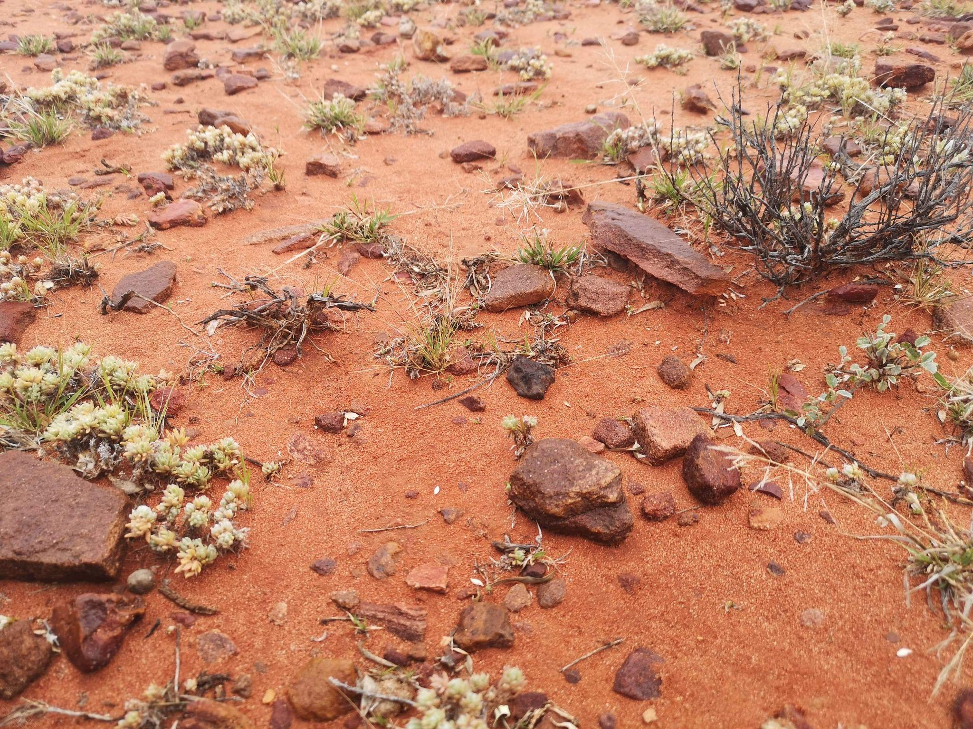

Slide 18
Logistical challenge
Power requirements
Computer 800W
Drone charging 1000W

Slide 19
Software Improvement Project
Limit the number of things that can go wrong
Process data off-site via Starlink
Crowdsourcing meteorite candidates review
Control the entire survey process from webapp

Slide 20
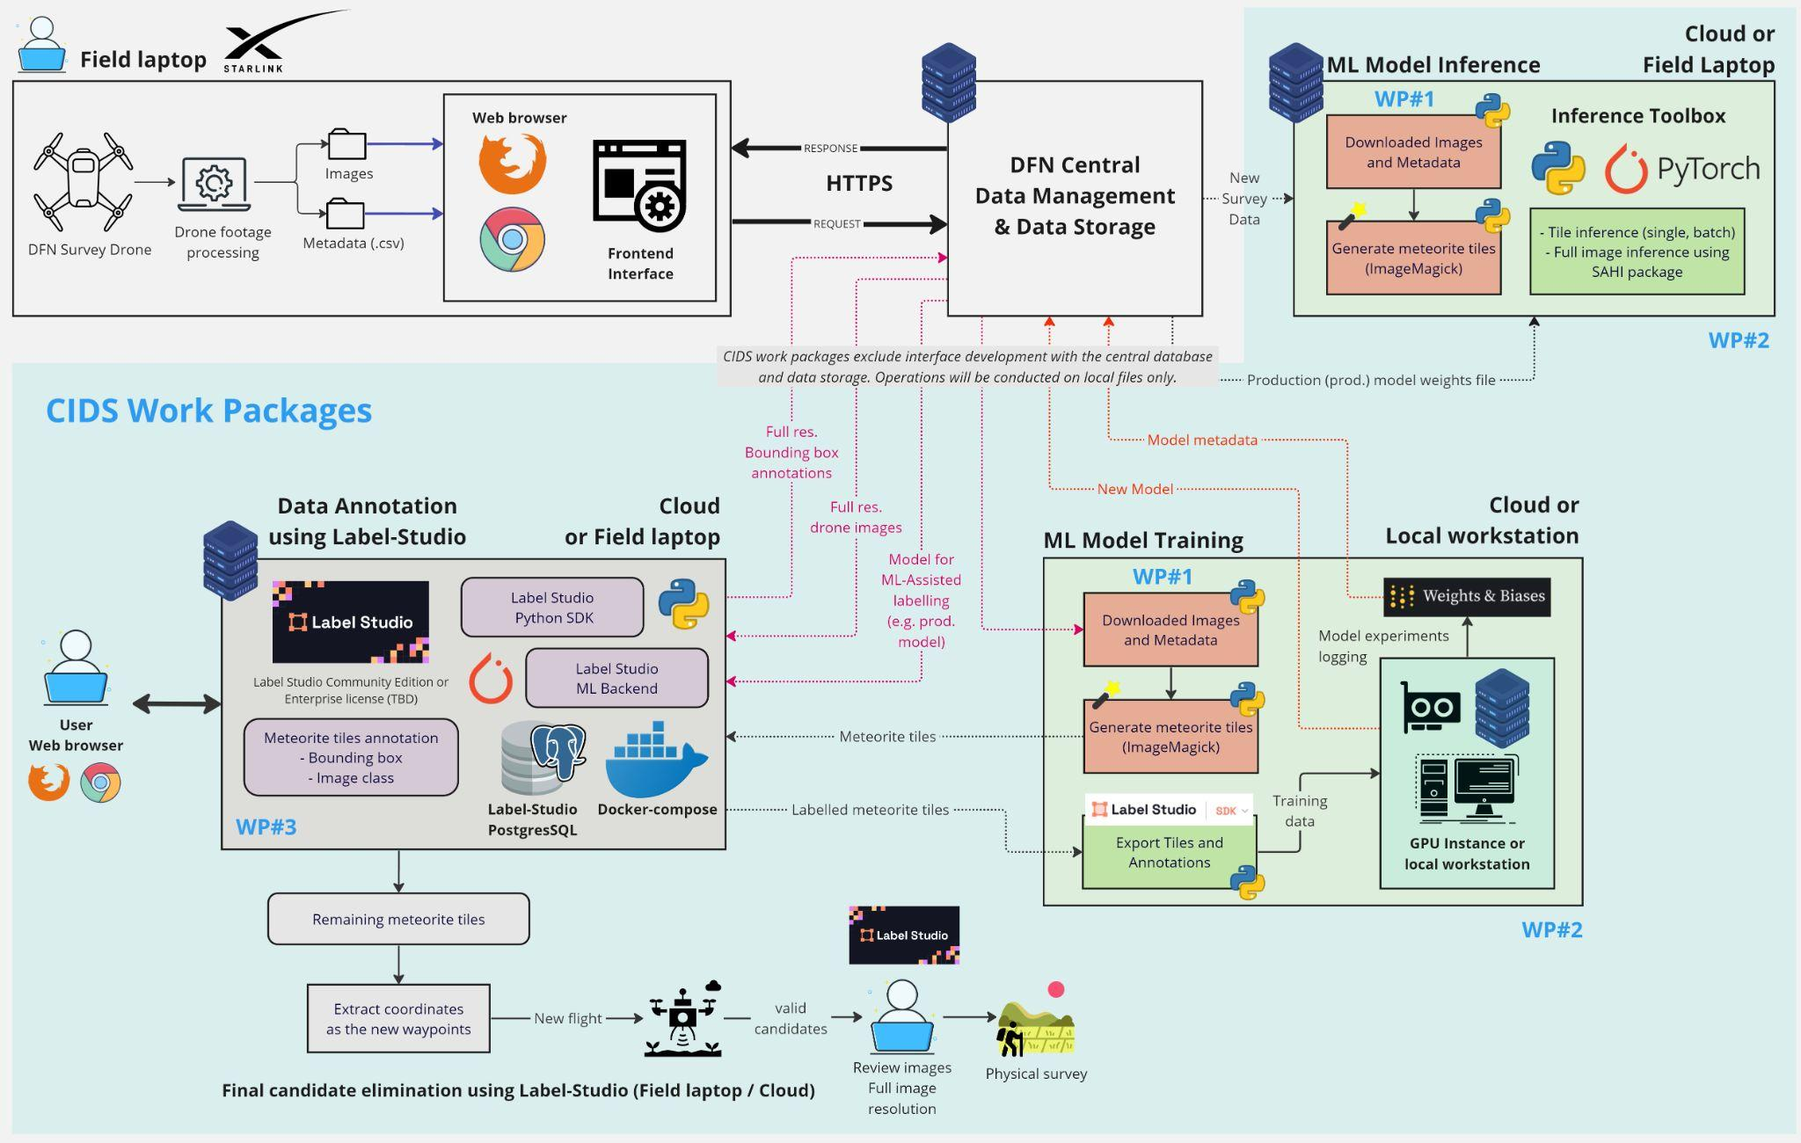

Slide 21
Thermal
Antarctica
No need to fully resolve the object

Slide 22
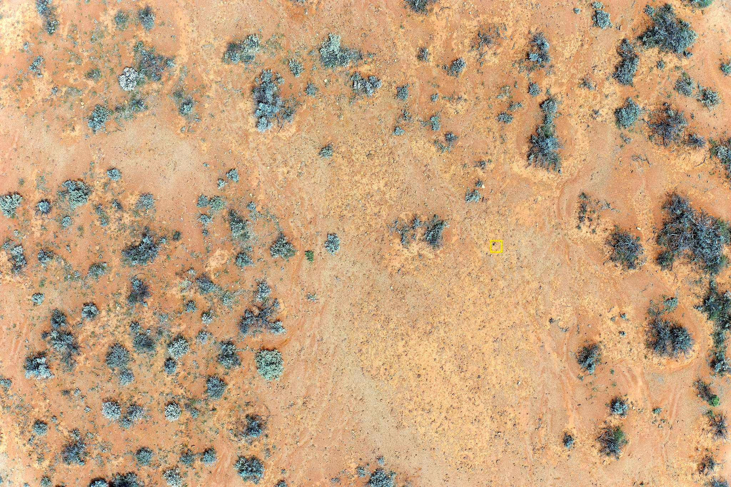

Slide 23
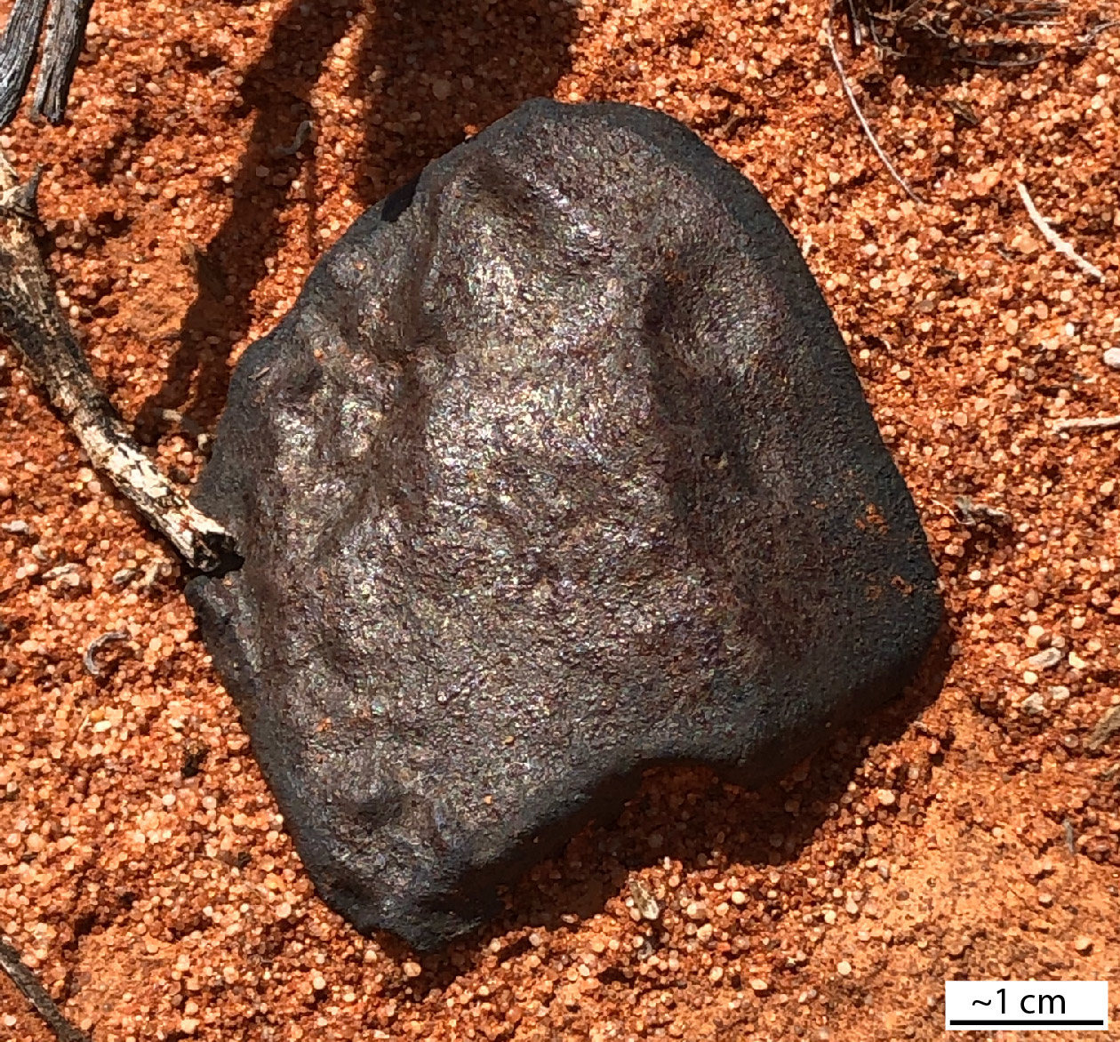

Slide 24
Power requirements
Computer 800W
Drone charging 1000W

Slide 25
Summary
Order of magnitude reduction in time for meteorite recovery
1.6 km² per day (1.8 mm/pixel resolution)
Smallest detectable meteorite: 2 cm diameter

Slide 26
Future directions
Making the software scalable
Crowdsourcing candidates review
Find lots of meteorites
Try it on new terrains
Open to collaboration

Slide 28
